Slide 1
Python2 Hobby Tracker
Milestone 4 (Final Presentation)
By: Johnny Gilbert, Nathan Bennett, Nathaniel Buchanan,
Taylor Miller, Spencer Deuscher Team: Python2
Session: Afternoon (Section: 100)

Slide 2
Milestone 4 Accomplishments
Finished Hobby Page
User Ability to Delete Account
Updated Chart Logic & Visualization
Finished Sprite Logic & Visualization
Application is Released Online for the Entire World
Implemented All Planned Features

Slide 3
Tool Chain/Technology Stack
HTML/CSS
Static Analysis
pylint_django
Javascript
Chart.js
Pop-up Window with Forms
Python
Sprite Logic
Django
Django-speedinfo (Profiling)
Bootstrap 4
Crispy Forms
Gifs (for Sprites)
Profiling
django-speedinfo
SQLite3
Unit Testing
python3 manage.py test
Ubuntu/WSL
Dynamic Analysis
Valgrind for Python
GitHub
Visual Studio Code

Slide 4
Original Prototype

Slide 5
Version 1.0 Demo

Slide 6
Version Control: GitHub
Git Repo
Notes:
Johnny Gilbert

Slide 7
Static Analysis - pylint-django
Reflection
In most of our static analyzing of the code base pylint gave usually us 10/10’s on our code. If it wasn’t 10/10 the static analyzer only pointed out minor issues such as unused imports, snake casing, trailing white space or unnecessary parenthesis.
Notes:
Johnny

Slide 8
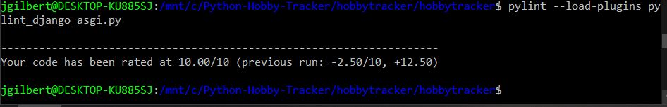
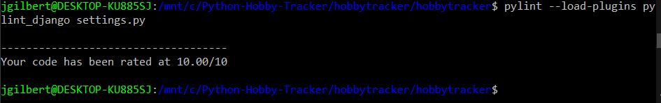
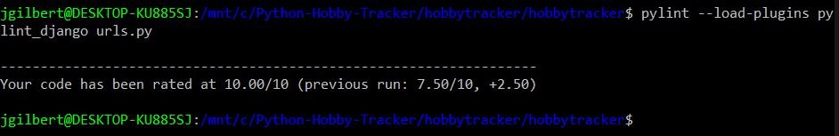

Slide 9
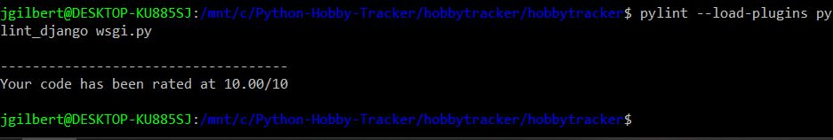
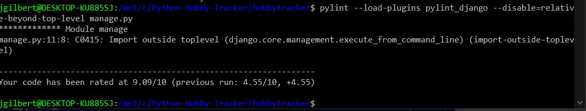
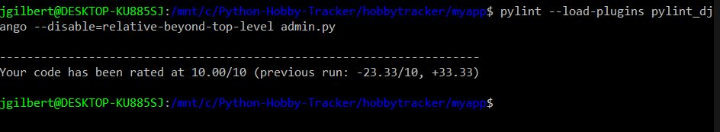

Slide 10
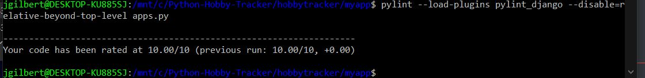
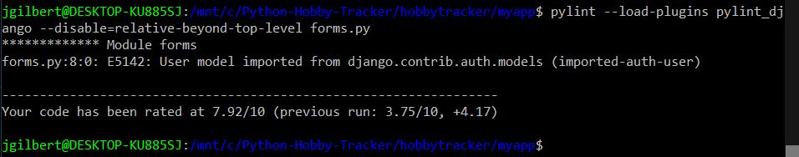
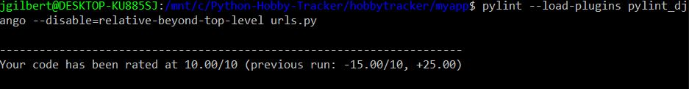

Slide 11
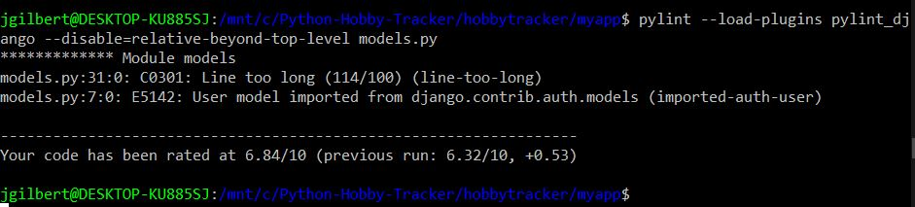
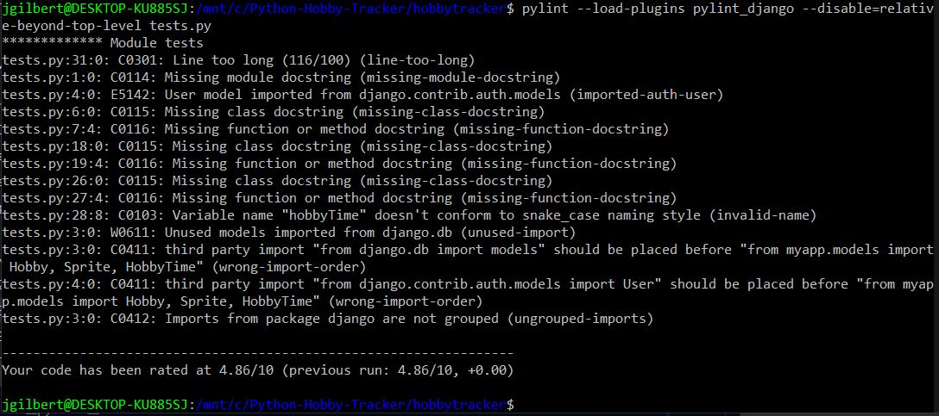

Slide 12
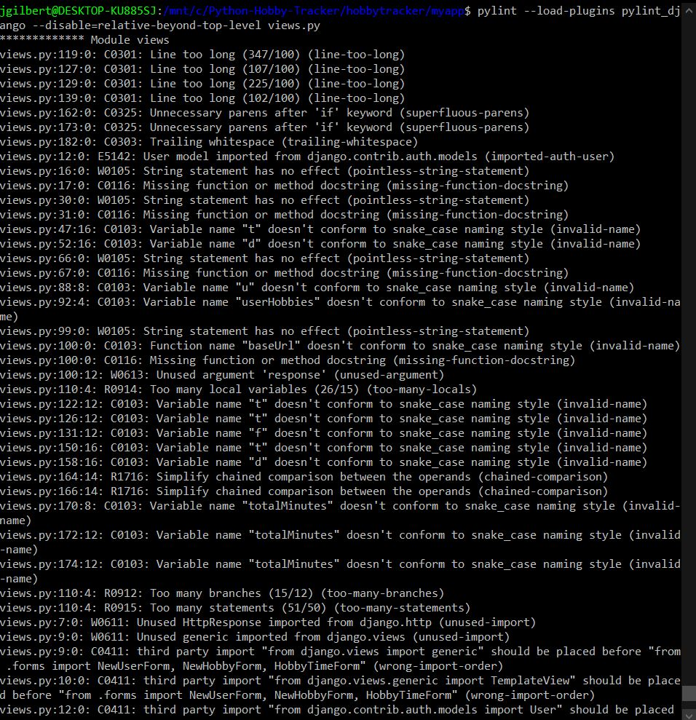
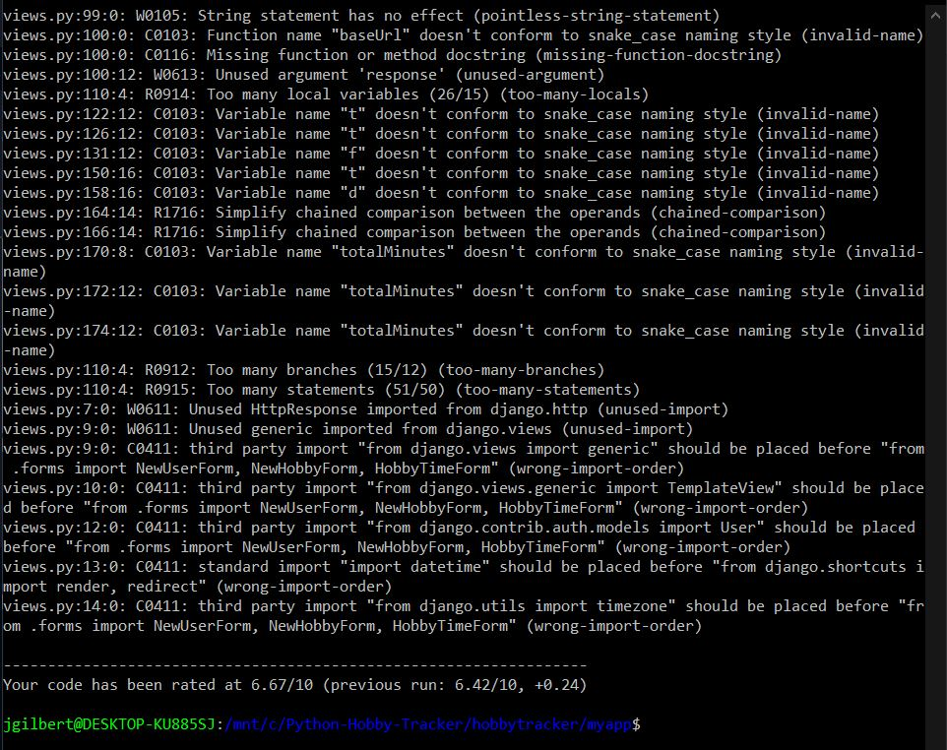

Slide 13
Unit Testing - python3 manage.py test
Reflection
Easily usable because it was built into django by using “python3 manage.py test”. Allowed us to test our object creation based off models, save to the database, and read from the database to test for proper object creation which was essential to our project.
Notes:
Johnny

Slide 14
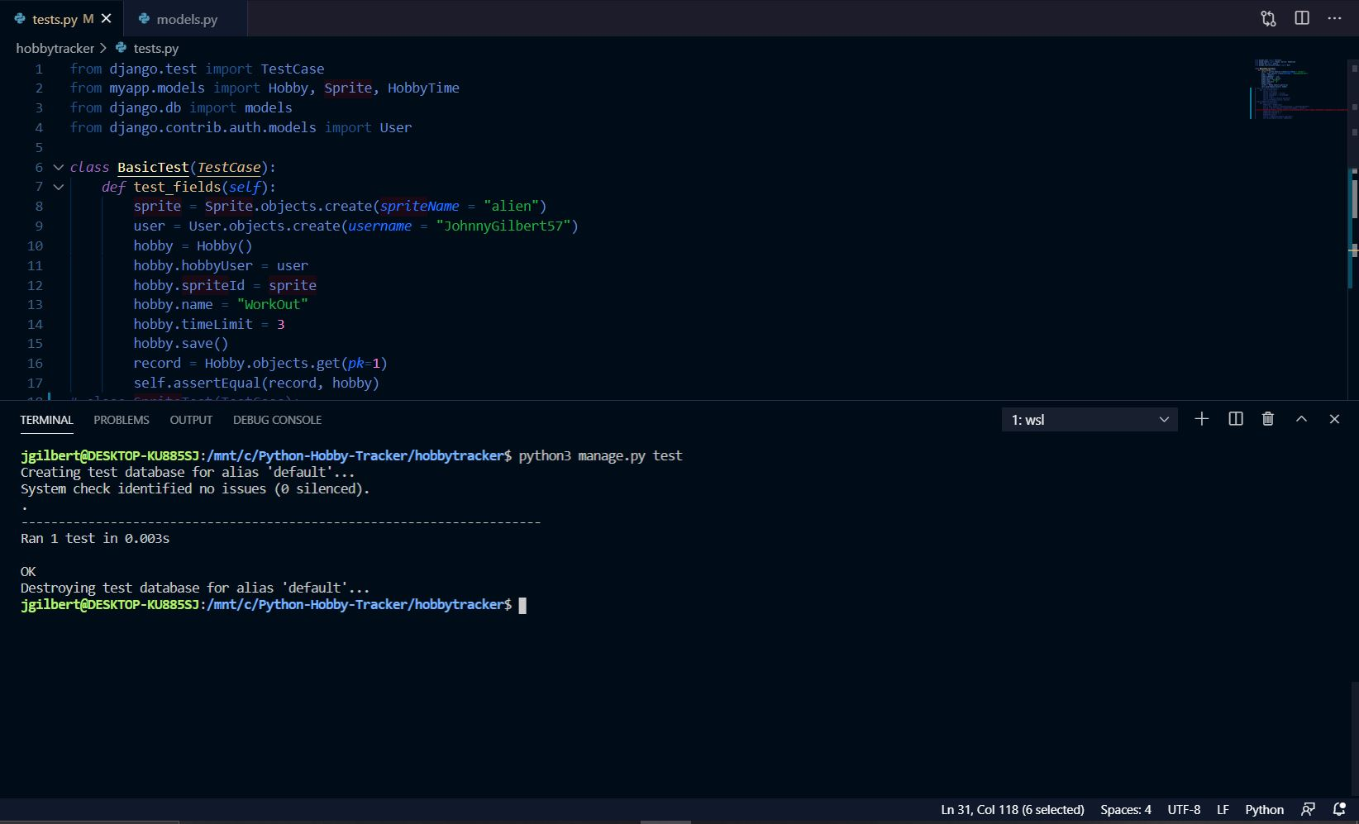
Johnny Gilbert’s Unit Test - Hobby Creation

Slide 15
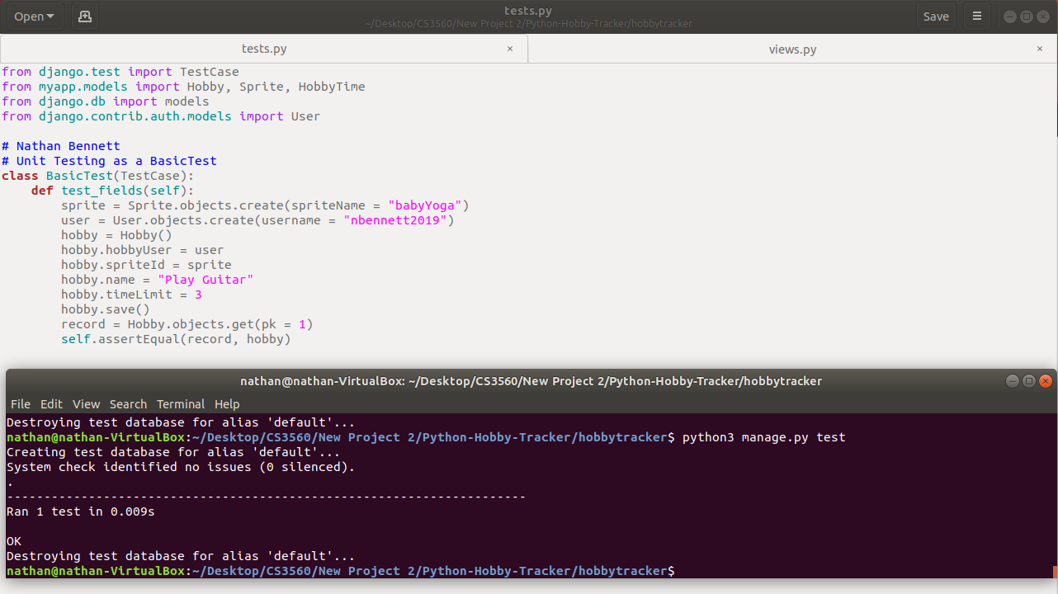
Nathan Bennett’s Unit Test

Slide 16
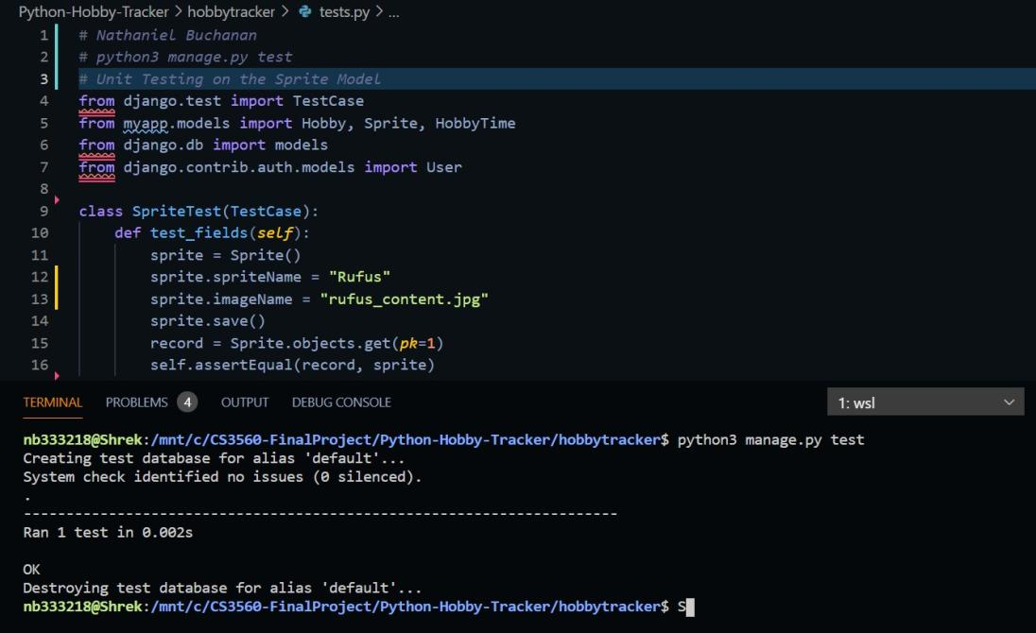
Nathaniel Buchanan’s Unit Test - Sprite Model

Slide 17
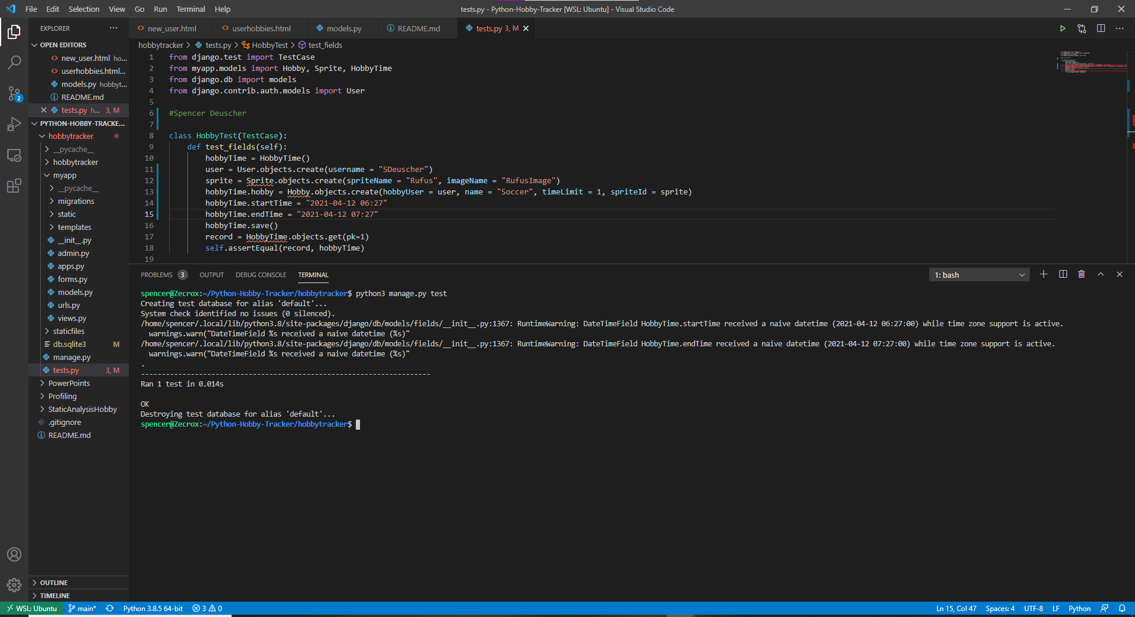
Spencer Deuscher’s Unit Test - Hobby Time

Slide 18
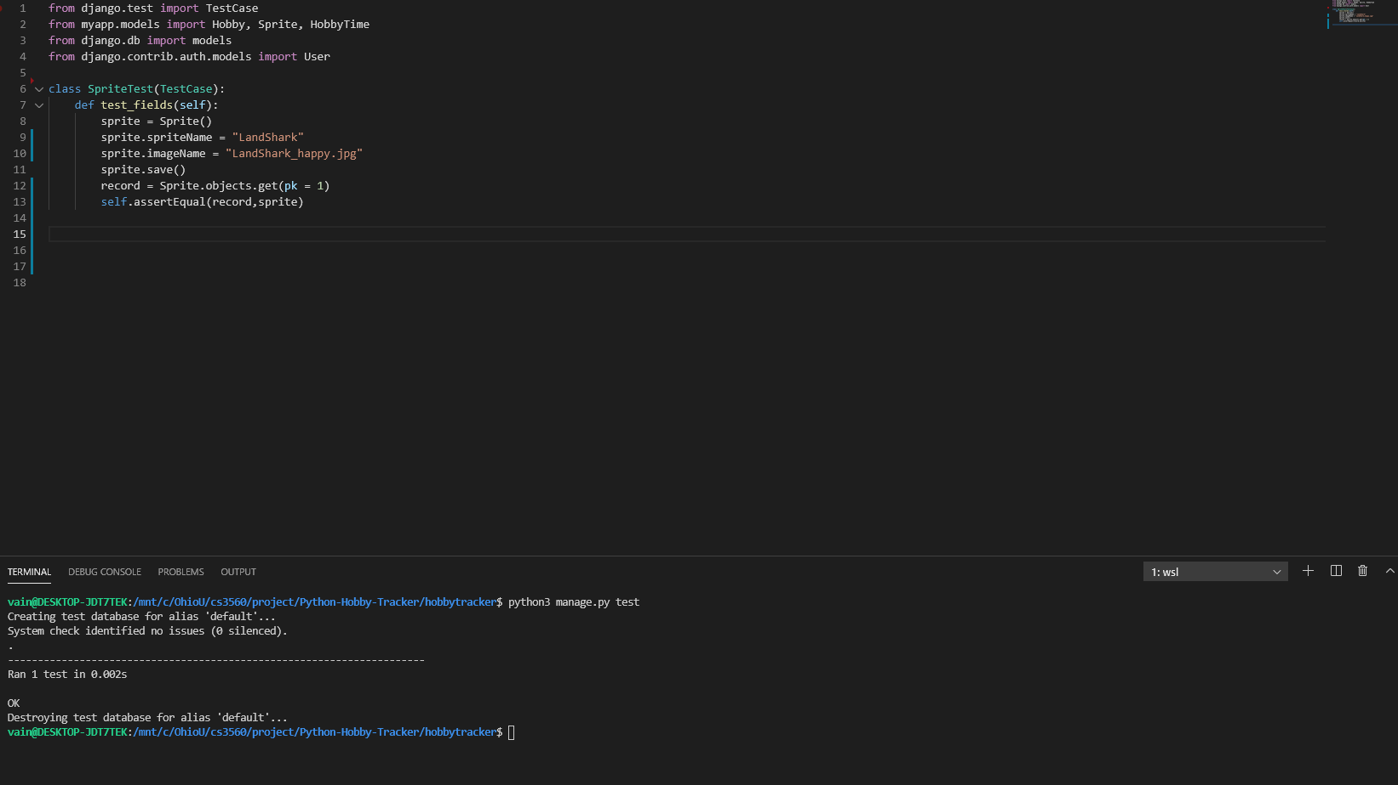
Taylor Miller’s Unit Test - Sprite Implementation

Slide 19
Profiling - Django Speedinfo
Reflection
The installation was quick and easy. There were only a couple of lines that needed to be added to the settings.py. After installation the tool was accessible from the admin site and was simple as hitting record, interacting with the site, and hitting stop recording.
Notes:
Johnny

Slide 20
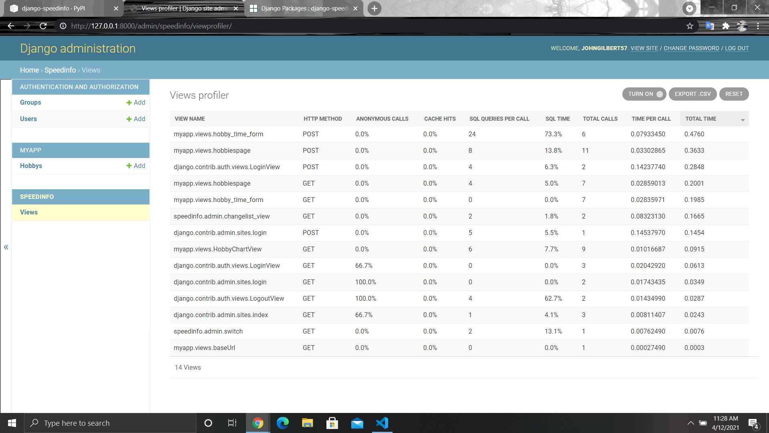

Slide 21
Dynamic Analysis - Valgrind
Reflection
Unfortunately there are no Django specific dynamic analyzers but we did have some luck running dynamic analysis strictly for python. As a whole the information was not that useful to us because it was throwing a lot of errors with imports and supported syntax for Django.
Notes:
Johnny

Slide 22
Individual Contributions

Slide 23
Johnny Gilbert - Maintainer and Front-End Developer
Meetings Attended: 21/21
Completed Tasks: Performed static analysis on the code base, contributed to sprite logic, merged over any branches still left in development, worked on queries to get database, finished styling of hobby page, created delete account functionality, and did profiling on the website
Role: maintainer and front end developer
Tools: WSL, VSCode, GitHub, bootstrap/crispy forms and Windows.
Notes:
Johnny

Slide 24
Nathan Bennett - Developer, Web Server, Database/ORM, Forms
Meetings Attended: 21/21
Completed Tasks: Created a basic form to input time spent per hobby, began sending dates and time spent per hobby to the chart, worked on getting data for sprite logic, and continued to keep web server up to date.
Role: Database, Forms, & Web Server
Tools: Ubuntu VM, VSCode
Notes:
Nathan

Slide 25
Nathaniel Buchanan - Developer & Front-End Developer
Meetings Attended: 21/21
Completed Tasks: Focused on front-end development, but also worked on some of the back-end. Would often work on the HTML and CSS for many of the webpages. Worked and learned Chart.js and created a proper chart. Assisted with Sprite implementation and art creation. Brief work with django and database.
Role: Front-end/Back-end development of the application; note-taker; collaborate with each member on issues
Tools: Windows 10 PC, Windows 10 Laptop, Ubuntu, WSL, VSCode
Notes:
Nathaniel

Slide 26
Spencer Deuscher - Developer, Researcher, Bootstrap 4
Meetings Attended: 21/21
Completed Tasks: Researched HTML, CSS, Bootstrap and Python logic to get a better understanding and be able to navigate the code better. Started the .gitignore file and have insert the file types into the .gitignore. Implemented Crispy Forms onto the Login and New User pages which was Issue 6 for our project on GitHub and got the pull request taken care of. Styled the “Add a Hobby” popup using Bootstrap 4.
Role: Styling forms with bootstrap/crispy forms, collaborate with other team members
Tools: WSL, VS Code, Ubuntu, GitHub, Windows 10 PC/Laptop
Notes:
Spencer

Slide 27
Taylor Miller - Developer, Py Logic Developer, Researcher, Sprite Implementation
Meetings Attended: 21/21
Completed Tasks: Research, Experimentation, Organization, Powerpoint Creation, Sprite Logic Implementation and Testing, Unit Testing for Sprite Logic
Role: Implementing sprites on to the web page, as well as implementing background logic for sprite selection
Tools: WSL, VS Code
Notes:
Taylor

Slide 28
The Team
Team Meetings: Tuesday: @5:00 pm & Friday: @3:00 pm on Discord
Workflow: Branched (with Issues) because of complications with multiple people working at once
Notes:
Spencer

Slide 29
Overall Reflection on Project
What we liked:
The overall goal/idea of the project
Django as a Framework
DB SQLite as a database
Many available online tutorials
What we disliked:
Django not being very applicable with the tools
Static Analysis was very difficult
SCSS created difficulties for CSS
DB SQLite caused problem with User Database*
Django didn’t have a lot of built in styling tools for html like other web development applications such as angular
What we would improve:
Additional Features:
Larger Variety of Sprites
Additional Charts
Multi-Browser functionality
Better Format for CSS
Greater Documentation
Change Time Zone runs off UTC

